Slide 1


PROJECT REPORT
ON
TELEMEDICINE PLATFORM
Carried Out at
CENTRE FOR DEVELOPMENT OF ADVANCED
COMPUTING ELECTRONIC CITY, BANGALORE.

Slide 2
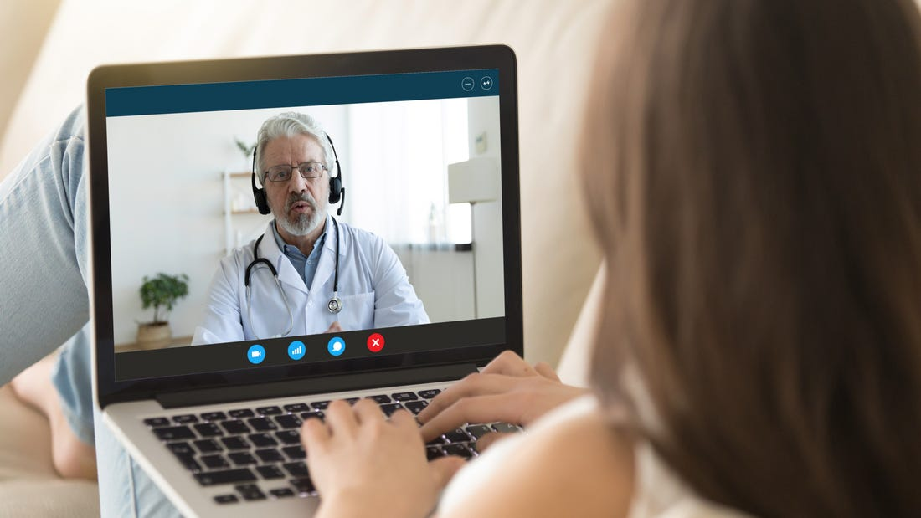
Project Title:
Telemedicine Platform
Submitted By:
Aditya Pawar,
Anurag Savardekar,
Vijayalaxmi Kore,
Omkar S Kumbhar,
Rajesh K.
Institution: C-DAC, Bangalore
Supervisor: Mr. Shanmuganathan N

Slide 3

INTRODUCTION
The healthcare industry faces challenges like long wait times and limited access.
Telemedicine provides digital healthcare solutions for remote services.
Ayu-Care integrates real-time video consultations, ML-based disease prediction, and chatbot assistance.

Slide 4
Problem Statement
Challenges in Traditional Healthcare:
Long waiting times for consultations.
Geographical barriers limiting healthcare access.
Inefficient medical record management.
Lack of AI-driven predictive healthcare solutions.

Slide 5
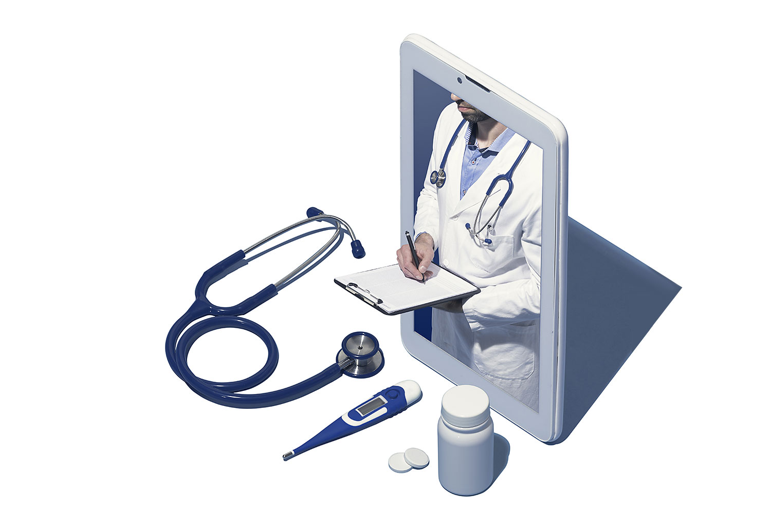
Objectives
✅ Provide real-time video consultations. ✅ Implement ML-based disease prediction. ✅ Develop an AI chatbot for 24/7 assistance. ✅ Ensure secure storage of medical data. ✅ Streamline appointment scheduling & tracking.

Slide 6

Telemedicine System Architecture
ppt free download
Technology Stack:
Frontend: React (User Interface)
Backend: Java Spring Boot (Business Logic)
Database: MySQL (Data Storage)
ML Module: Python (Disease Prediction)
Video Conferencing: WebRTC/Twilio
This slide is an editable slide with all your needs.
Adapt it with your needs and it will capture all the audience attention.
Capture your audience attention .
Download this awesome creatives and bring your presentation to life , with our creativity

Slide 7
Key Features
Comprehensive Digital Healthcare Solution:
Secure User Registration & Authentication
Real-time Video Consultations
AI-Powered Disease Prediction
Chatbot for Instant Support
HIPAA-Compliant Data Storage
Automated Appointment Scheduling & Notifications
Notes:
<a href="https://www.freepik.com/free-photos-vectors/medical">Medical vector created by freepik - www.freepik.com</a>

Slide 8

Implementation
Core Modules & Technologies Used:
User Management: Secure authentication & role-based access.
Video Conferencing: WebRTC/Twilio for seamless interactions.
ML Model: Trained on medical datasets for accurate predictions.
Chatbot: NLP-based assistant for real-time user guidance.
Database: MySQL for secure medical record storage

Slide 9
Security Considerations
Ensuring Data Safety & Compliance:
Encryption: Secure storage & transmission of patient data.
Role-based Access Control: Restrict access to sensitive data.
HIPAA Compliance: Follows global healthcare security standards.
Secure Communication: HTTPS and API security mechanisms.

Slide 10
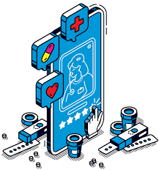
Challenges & Solutions
Challenges
Network inconsistencies in video calls
Data security concerns
Handling high user loads
Solutions :
WebRTC optimizations
AES encryption implementation
Cloud-based auto-scaling

Slide 11

Market Analysis & Trends
Growing Telemedicine Adoption: Rapid expansion post-pandemic.
Global Market Size: Expected to reach $185 billion by 2026.
Competitive Landscape: Comparison with other platforms.
Potential Market Segments: Hospitals, Clinics, Independent Practitioners

Slide 12
Future Enhancements
Multilingual Chatbot Support for diverse users.
Integration with Wearable Health Devices.
AI-driven Personalized Healthcare Recommendations.
Mobile App Development for improved accessibility.
Specialized Telemedicine Services (e.g., mental health, cardiology).
Notes:
<a href="https://www.freepik.com/free-photos-vectors/people">People vector created by pch.vector - www.freepik.com</a>

Slide 13
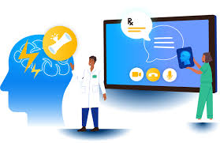
Business Model & Monetization
Subscription-Based Model for premium services.
Partnerships with Hospitals & Clinics.
Ad-Supported Free Model for wider accessibility.
Enterprise Licensing for Large Healthcare Organizations

Slide 14
Conclusion
✔️ Ayu-Care revolutionizes digital healthcare by bridging the gap between doctors and patients. ✔️ Ensures accessibility, efficiency, and predictive care. ✔️ Provides a secure, scalable, and user-friendly telemedicine experience. ✔️ Future plans include AI-driven insights and expanded healthcare services.

Slide 15
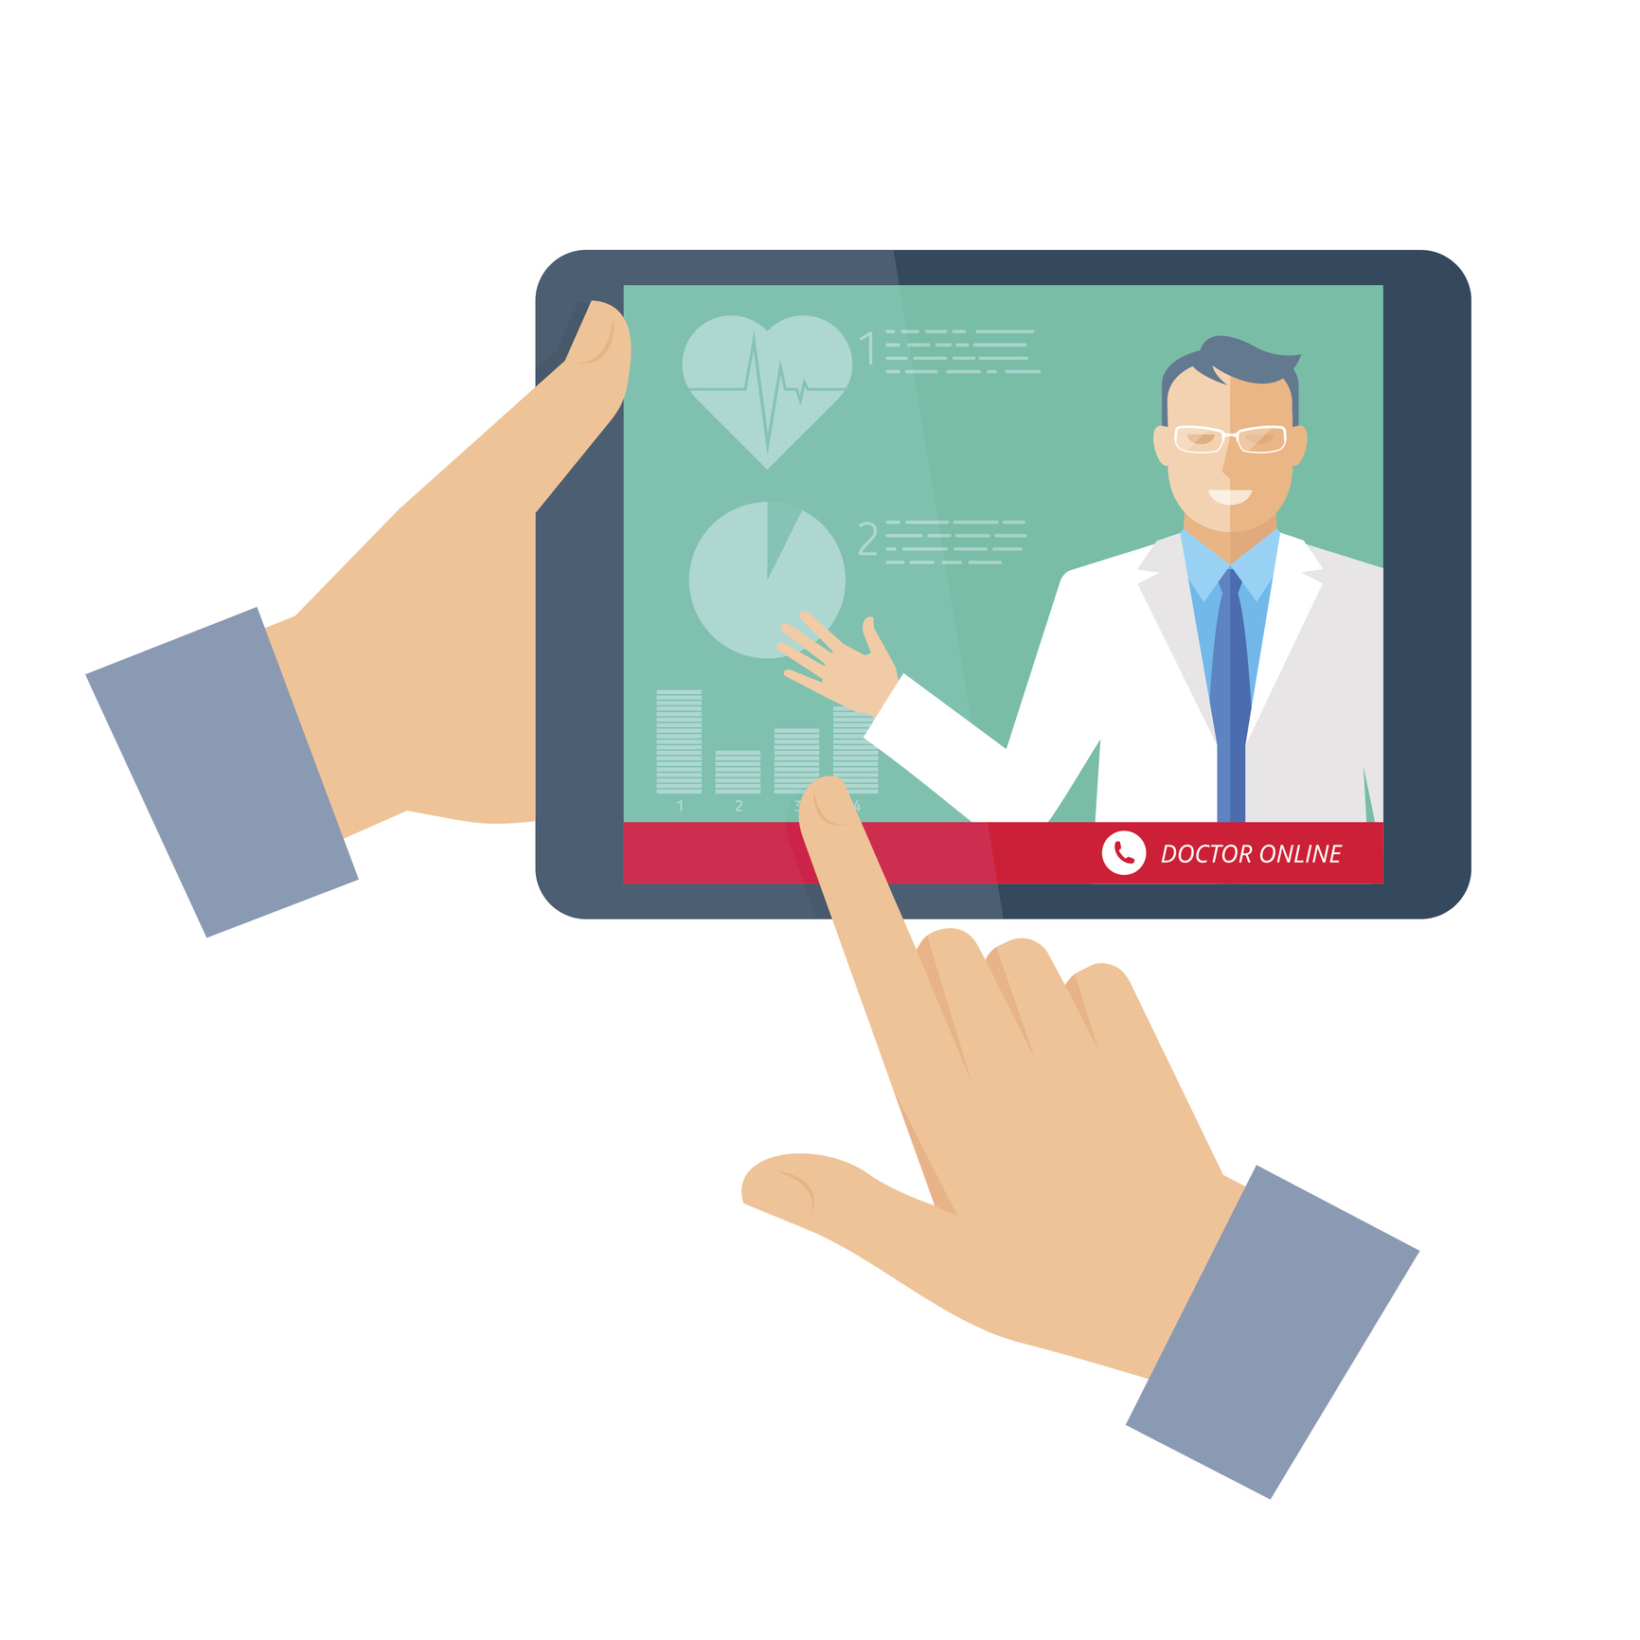
📚 References
🔹 Technical Documentation & Research Papers:
📌 Java Spring Boot Documentation
📌 MySQL & WebRTC Technical Guides
📌 IEEE Research Papers on Telemedicine
📌 HIPAA Compliance Guidelines
📌 Scikit-learn & TensorFlow for ML Implementation

Slide 16
THANK YOU
Notes:
<a href="https://www.freepik.com/free-photos-vectors/people">People vector created by pch.vector - www.freepik.com</a>

